Slide 1

EXPLORATORY DATA ANALYSIS ON WINE QUALITY
Group - 5

Slide 2
Introduction:
Now let's explore the quality of red wine by looking at its chemical characteristics and sensory experiences.
We'll be looking at a dataset that includes basic physicochemical characteristics of red wine, such as fixed acidity, volatile acidity, citric acid, residual sugar, chlorides, free sulfur dioxide, total sulfur dioxide, density, pH, sulphates, and alcohol, all of which converge to determine the wine's quality.
For customers to make wise decisions and for winemakers looking to improve their craft, it is essential to comprehend the elements affecting wine quality.

Slide 3
Dataset Overview:
Our dataset, "Redwinequality.csv," contains a wealth of data about the quality of red wines.
The overall quality grade is influenced by a number of factors, including density, pH, sulphates, alcohol, citric acid, residual sugar, chlorides, free sulfur dioxide, total sulfur dioxide, fixed acidity, volatile acidity, and quality.
A thorough evaluation of each wine sample is conducted using a scale ranging from 0 (very bad) to 10 (outstanding), offering a thorough understanding of wine quality.

Slide 4
EDA Methodology:
EDA methodology comprises several crucial steps to unearth insights from the data:
Data Acquisition: Loading the red wine quality dataset.
Preprocessing: Cleaning the data by handling missing values, detecting and treating outliers, and normalizing the data.
Exploratory Data Analysis (EDA): In order to find links and patterns, exploratory data analysis (EDA) involves visualizing the data using a variety of approaches, including heatmaps, boxplots, scatter plots, and category plots.
Our objective is to better comprehend the features of the dataset and how they relate to wine quality.

Slide 5
Key Insights:
Citric acid, sulphates, and alcohol all show a significant link with wine quality, suggesting their significance in identifying premium wine.
On the other hand, density and volatile acidity have a negative relationship with wine quality, indicating that these characteristics should be reduced for higher quality.
With fewer wines at the very low and high ends of the quality scale, the distribution of quality ratings shows a bias towards the medium range.

Slide 6
Visual Aids:
Correlation Heatmap: Visual representation of correlations between different variables, highlighting their strength and direction.
Quality Distribution: Histogram showcasing the distribution of wine quality ratings, providing an overview of the dataset.
Quality and Fixed Acidity: Boxplot demonstrating the distribution of fixed acidity across different quality ratings.
Residual Sugar and Alcohol Content: Scatter plot illustrating the relationship between residual sugar and alcohol content.

Slide 7
Visual Aids:
Wine Quality and pH: Plot showcasing the negative correlation between wine quality and pH levels.
Quality and Volatile Acidity: Box plot indicating the relationship between wine quality and volatile acidity.
Citric Acid Content and Wine Quality: Line graph displaying the relationship between citric acid content and wine quality.

Slide 8
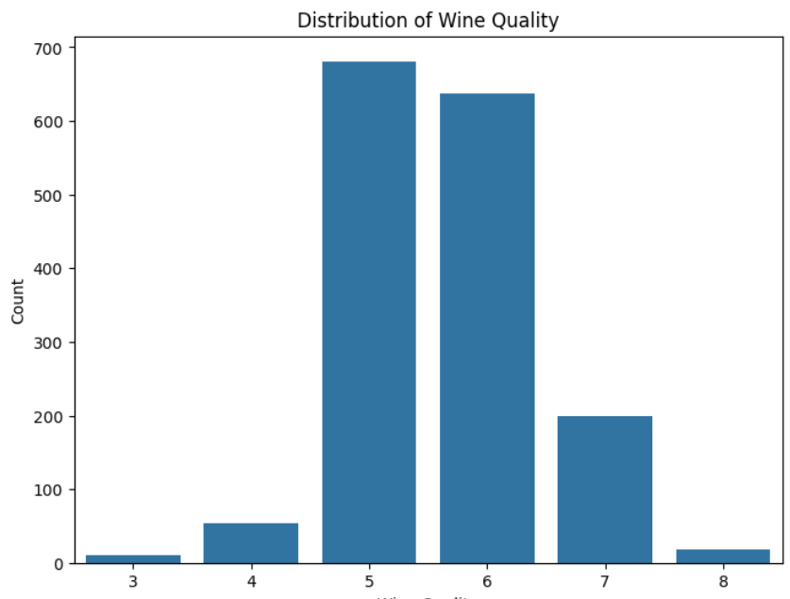
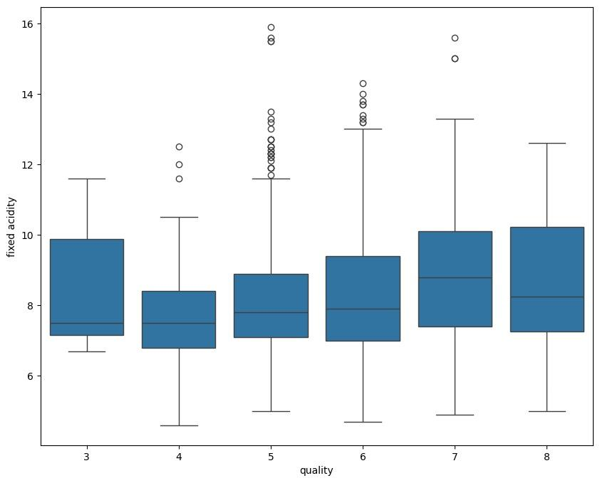
Graphs:
Correlation between two variables

Slide 9
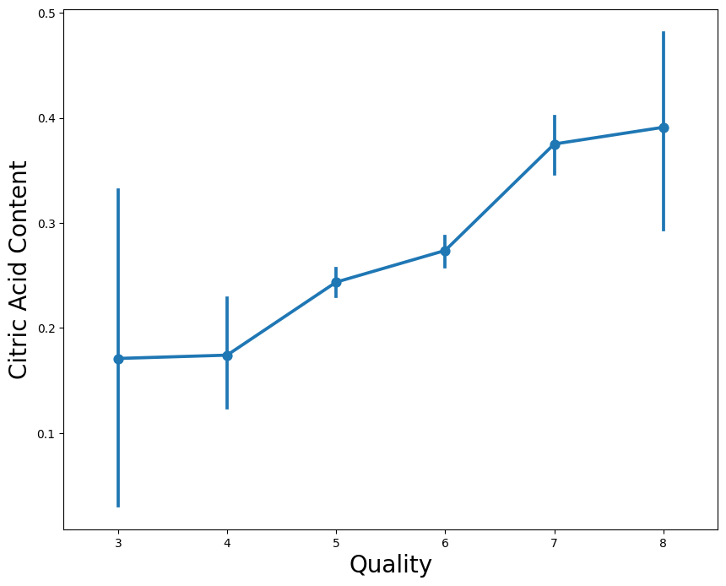
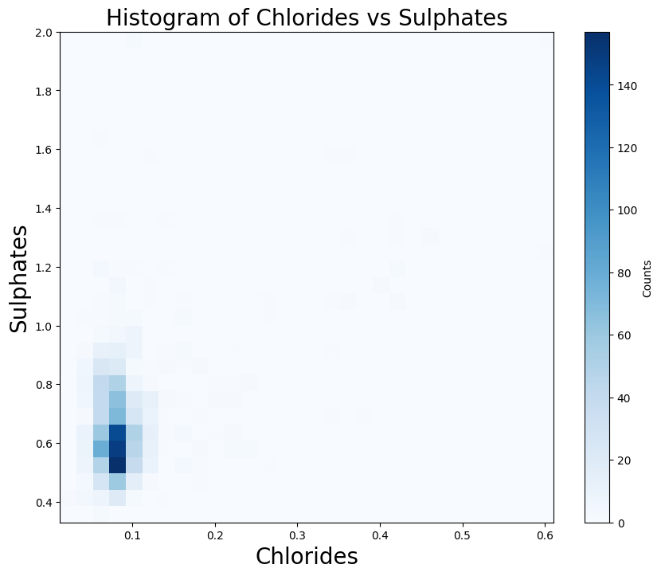
Graphs:
Line graph
Histogram

Slide 10
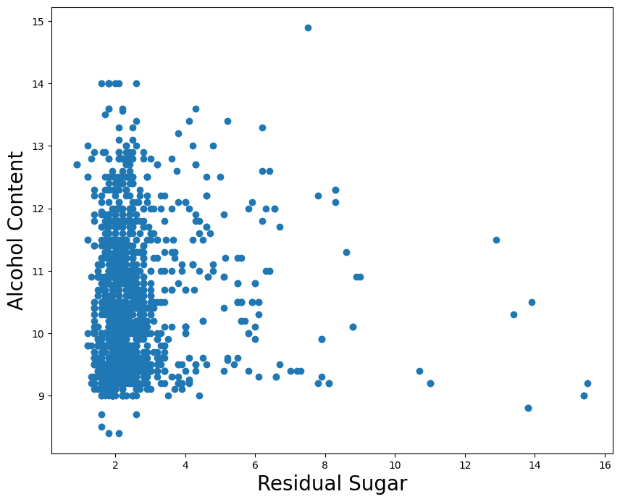
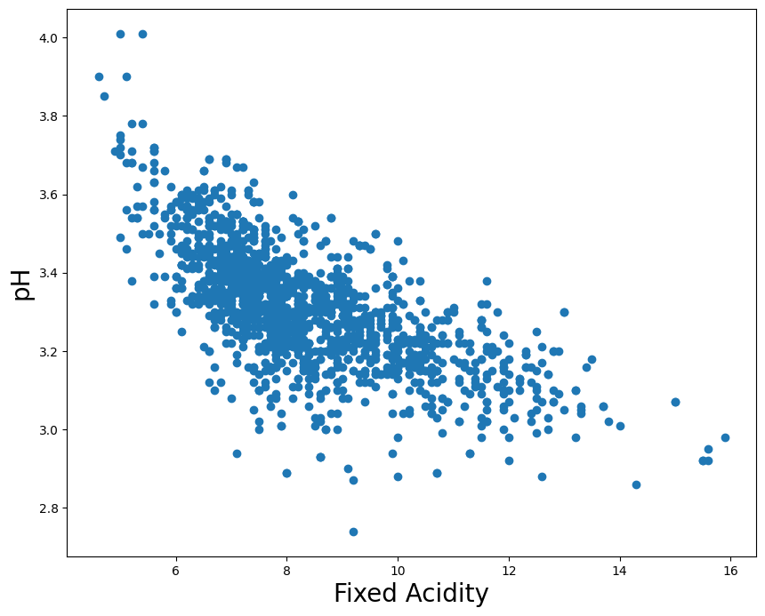
Graphs:
Graph displays a scatter plot

Slide 11
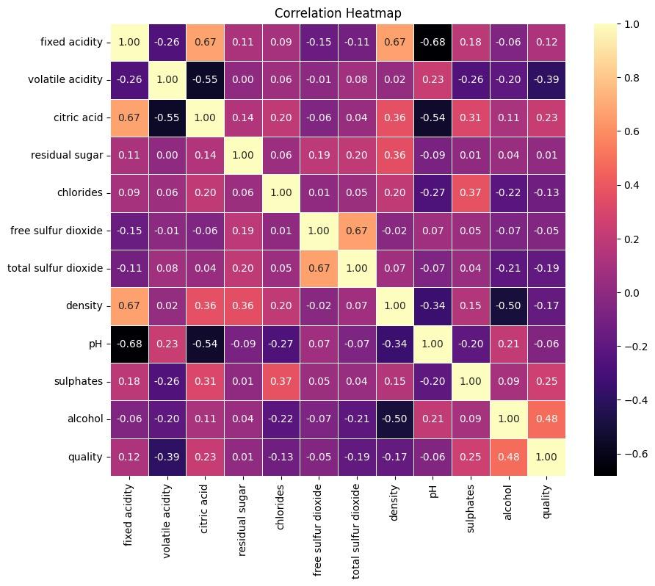
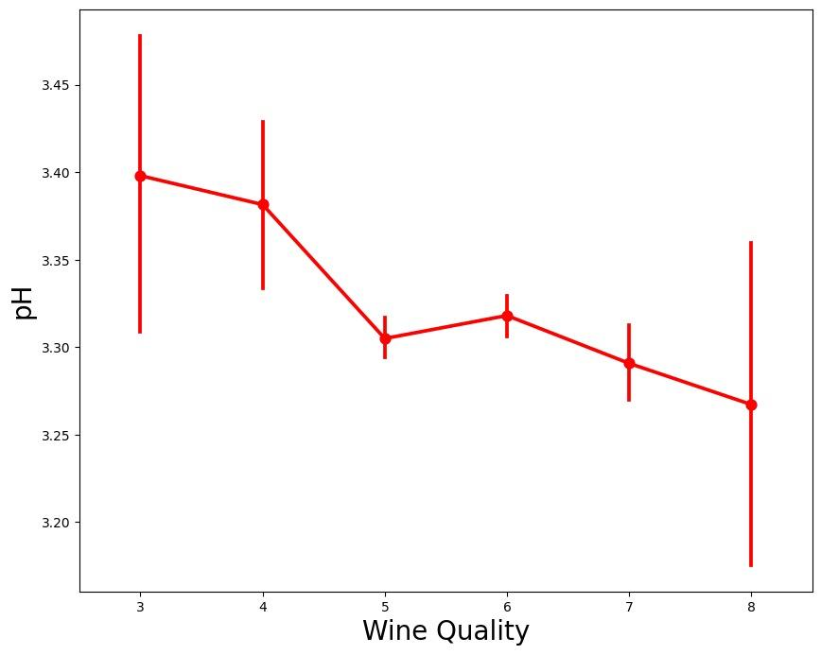
Graphs:

Slide 12
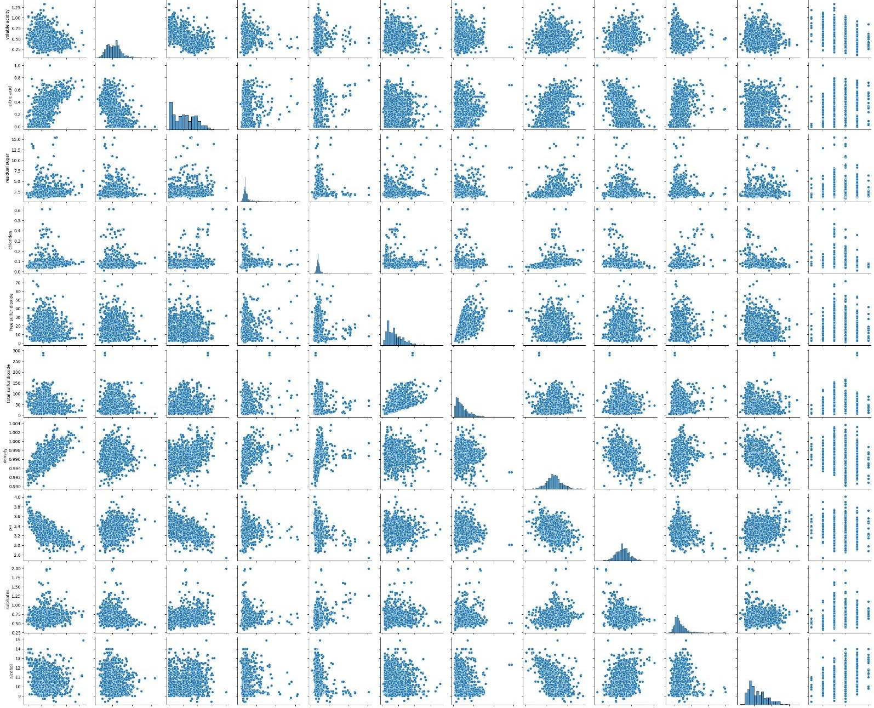
Graph:

Slide 13
Red Wine Quality Prediction
Created binary label high_quality (quality ≥ 7)
Split data into regression and classification tasks
Goal: Predict quality score and classify high vs. low quality

Slide 14
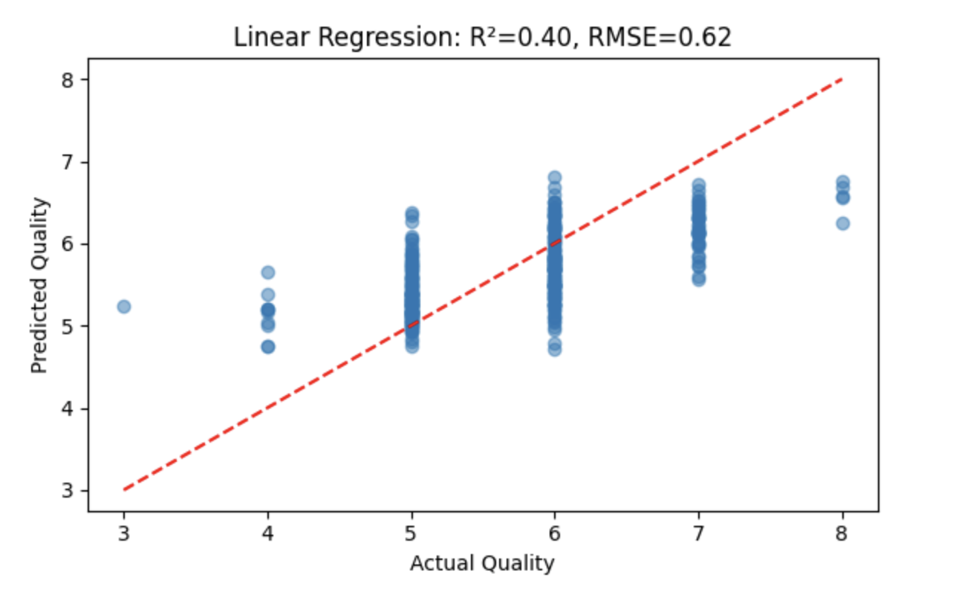
Linear Regression
• R² ≈ 0.40, RMSE ≈ 0.62
• Predicts numeric wine quality

Slide 15
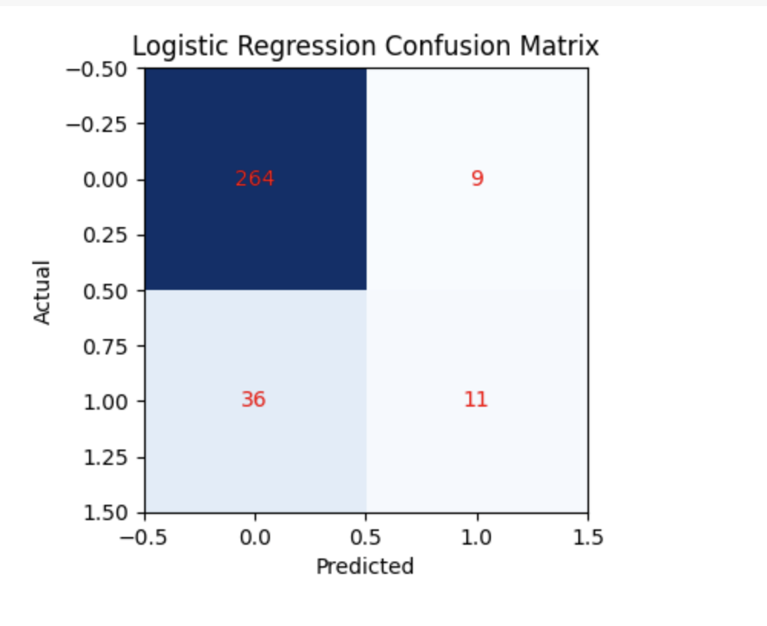
Logistic Regression
• Accuracy ≈ 86%
• Precision ≈ 55%, Recall ≈ 23%, F1 ≈ 33%
• Struggles with class imbalance

Slide 16
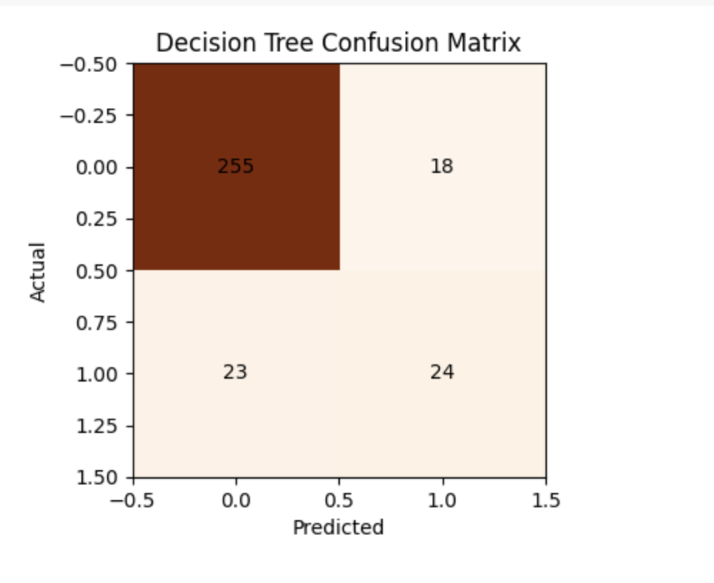
Decision Tree
• Accuracy ≈ 87%
• Precision ≈ 57%, Recall ≈ 51%, F1 ≈ 54%
• Improved minority class performance

Slide 17
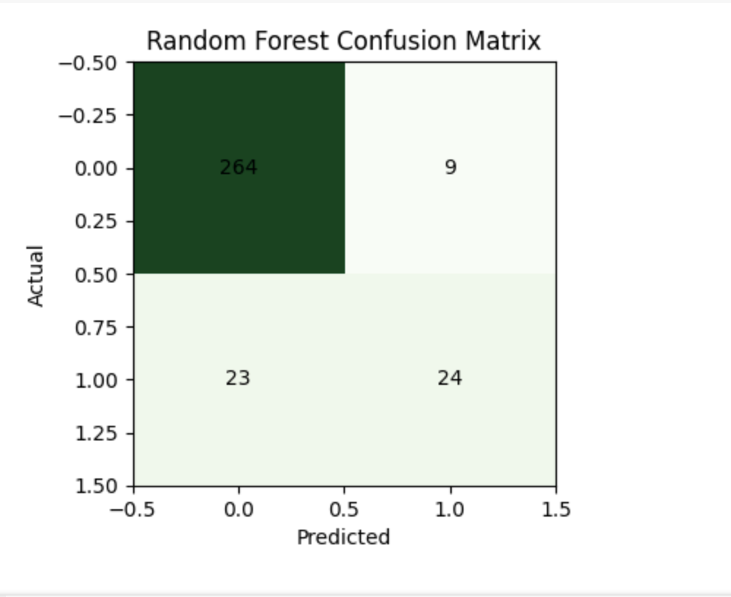
Random Forest
• Accuracy ≈ 90%
• Precision ≈ 73%, Recall ≈ 51%, F1 ≈ 60%
• Top features: alcohol, sulphates, volatile acidity, density

Slide 18
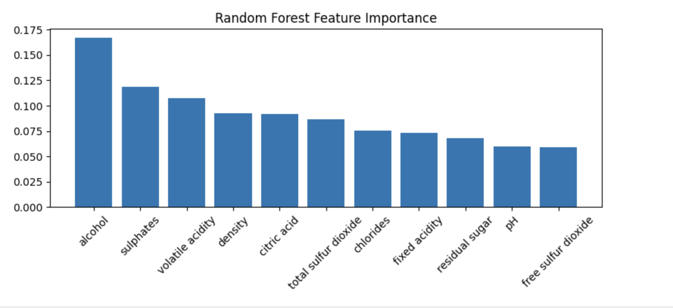
Feature importance

Slide 19
• Apply SMOTE or resampling to improve recall • Tune hyperparameters (GridSearchCV) • Explore more features or additional data
Recommendations after Machine Learning Techniques

Slide 20
Recommendations
Based on our analysis, we recommend:
To improve wine quality, winemakers should concentrate on maximizing amounts of alcohol, sulphates, and citric acid.
Minimizing density and volatile acidity to enhance overall quality.
To have a more thorough knowledge, subsequent research might examine other elements affecting wine quality, such as grape variety and fermenting methods.

Slide 21
Conclusion:
Our EDA of the dataset on red wine quality offers important new information about the variables affecting wine quality. The significance of several chemical features and their connection to quality ratings are highlighted by our investigation. Both winemakers and customers may find these insights useful.
Winemakers can improve their production methods and consumers can make well-informed decisions by utilizing data-driven tactics.
Let's celebrate a greater understanding of the art and science underlying the quality of red wine!

Slide 22

THANK YOU!

